Slide 1
Load Management System

Slide 2
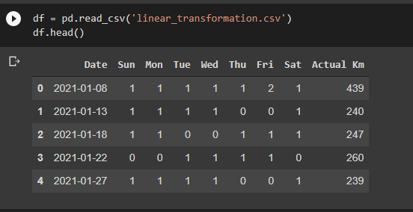
Linear Transformation

Slide 3
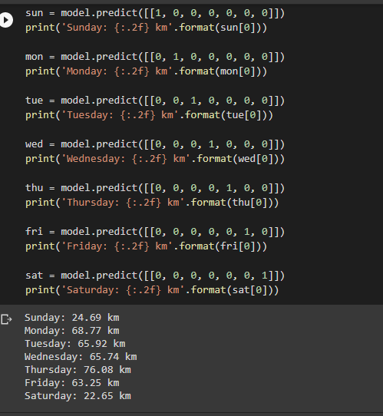
Model Outputs

Slide 4
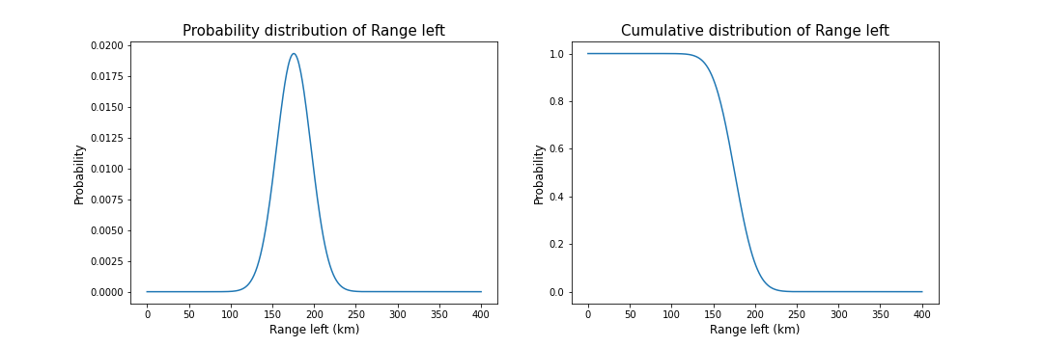
Probability Distribution of Range left (km)

Slide 5
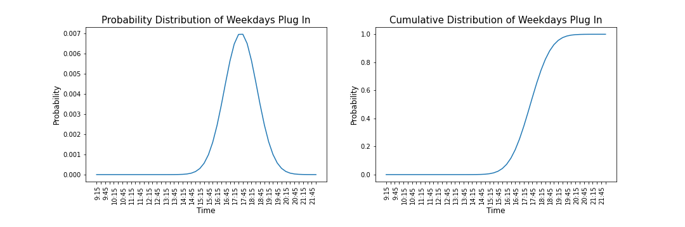
Probability Distribution of Plug In values on Weekdays

Slide 6
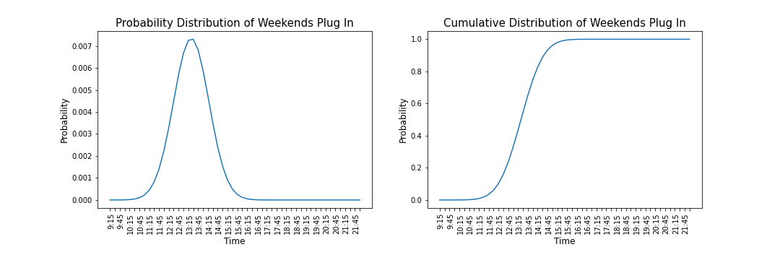
Probability Distribution of Plug In values on Weekdays

